Slide 1




Shortest Path Planning in Polygonal World for an Autonomous Mobile Robot
Faculty of Computers & Artificial Intelligence

Slide 2
Supervisor
Group members:
1)Peter Hany Hosny
2)Mahmoud Ahmed Mohamed Tawfiq
3)Hamed Mohamed Hamed Abdel Hamed
4)Ahmed Emad Saeed Khallaf
5)Wesam Sultan Ahmed Sultan
6)Ahmed Tariq Saber Amin Ali
7)Saleh Abdul Hakim Saleh Babakri
Dr. Mahmoud Wahdan
TA. Osama Assas
TA. Hazem Omar

Slide 3
AGENDA
1. Problem statements
2. Polygonal World and Voronoi diagram
3. Paths Class ( Undirected and Directed )
4. Tangents on Polygons
5. Canonical Paths and Directed v-edges Sequences
6. Connectivity Graph and Sub-Polygons
7. Dijkstra Algorithm
8. Finding the Best Path Class
9. Image of Point on Convex Polygon
10. visibility
11. Project Flow
12 . Demo
13 . Testing

Slide 4
Problem Statements
1. Develop an algorithm to solve the shortest path planning for a point robot in a polygonal world. This is one of the most fundamental problems in robotics.
2. To find the globally shortest path, first find the locally shortest path in each path class. Next, find the globally shortest path among those locally shortest paths.
3. The problem of shortest path through free space of a two dimensional, world model with convex polygonal obstacles from a start point to a goal

Slide 5
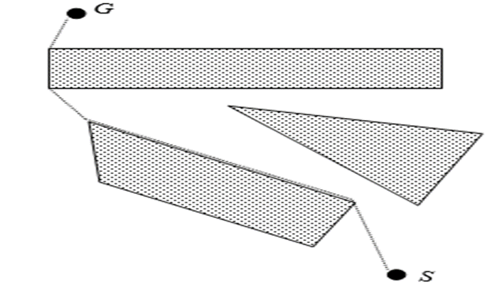
Problem Statements
4. In this problem, given a world W which consists of n convex polygons and two points S and G in free(W) , we want to find the shortest path in free(W)
5. The shortest path consists of a sequence of four kinds of path segments :
·A tangent from S to a polygon.
·Common tangents between two polygons.
·A tangent from a polygon to` G.
·calling modified Dijkstra’s algorithm

Slide 6
AGENDA
1. Problem statements
2. Polygonal World and Voronoi diagram
3. Paths Class ( Undirected and Directed )
4. Tangents on Polygons
5. Canonical Paths and Directed v-edges Sequences
6. Connectivity Graph and Sub-Polygons
7. Dijkstra Algorithm
8. Finding the Best Path Class
9. Image of Point on Convex Polygon
10. visibility
11. Project Flow
12 . Demo
13 . Testing

Slide 7
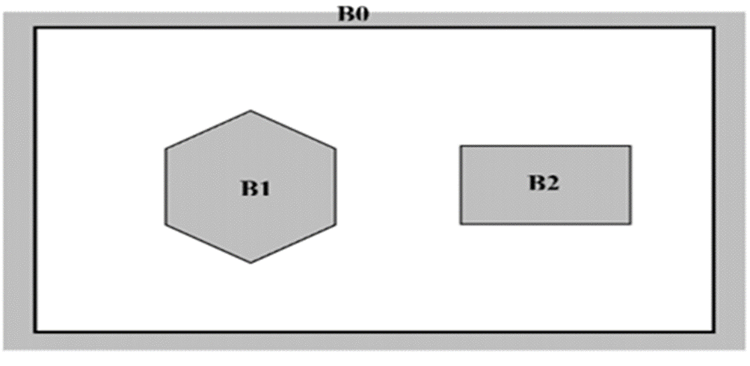
Polygonal World
1 - W= {B0,B1,….,Bn}, n > 0
Note :-
W = Free world

Slide 8
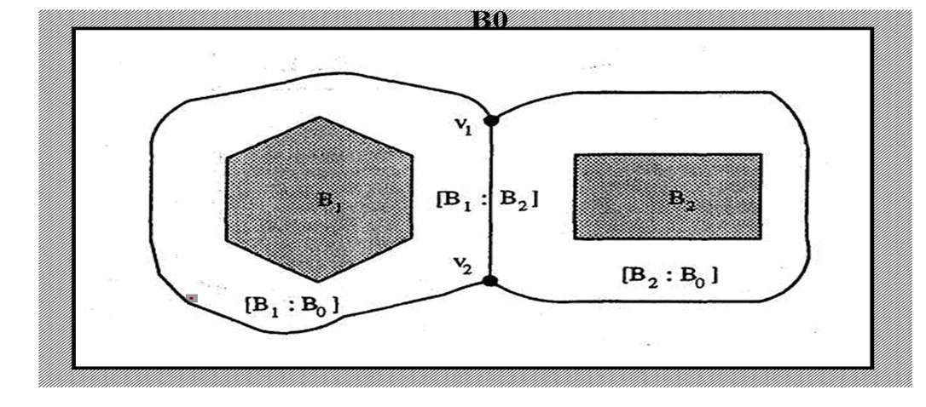
Voronoi diagram
1 - Between two Straight line
2 - Between line and node
3 - Between two node

Slide 9
AGENDA
1. Problem statements
2. Polygonal World and Voronoi diagram
3. Paths Class ( Undirected and Directed )
4. Tangents on Polygons
5. Canonical Paths and Directed v-edges Sequences
6. Connectivity Graph and Sub-Polygons
7. Dijkstra Algorithm
8. Finding the Best Path Class
9. Image of Point on Convex Polygon
10. visibility
11. Project Flow
12 . Demo
13 . Testing

Slide 10
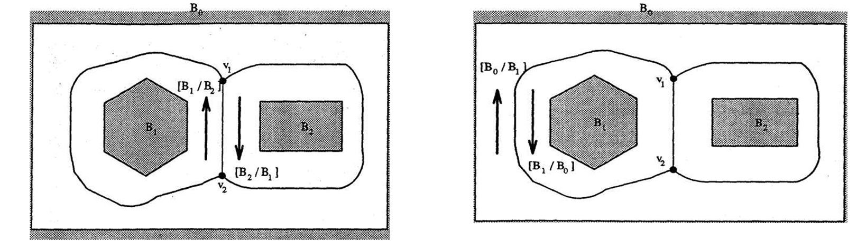
Path Class Directed
1 - ξ = [Bi / Bj]
2 - [Bi : Bj] and [Bj : Bi] are considered not the same
Note :-
ξ = v-edge

Slide 11

Path Class Undirected
1 - undirected v-edge £ = [Bi : Bj]
2 - [Bi : Bj] and [Bj : Bi] are considered the same
Note :-
£ =v-edge

Slide 12
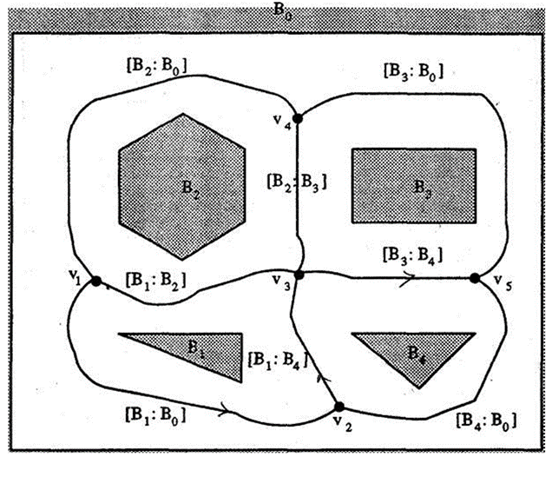

Path Class Undirected
1. A world W consists of five polygons B0, B1, B2, B3 and B4
2. There are five v-nodes
3. Eight undirected v-edges [B1 : Bo],
[B1 : B2], [B2 : B0],[B2: B3], [B1 : B4],
[B4 : Bo],[B3 : B4], and [B3 : B0].

Slide 13
AGENDA
1. Problem statements
2. Polygonal World and Voronoi diagram
3. Paths Class ( Undirected and Directed )
4. Tangents on Polygons
5. Canonical Paths and Directed v-edges Sequences
6. Connectivity Graph and Sub-Polygons
7. Dijkstra Algorithm
8. Finding the Best Path Class
9. Image of Point on Convex Polygon
10. visibility
11. Project Flow
12 . Demo
13 . Testing

Slide 14
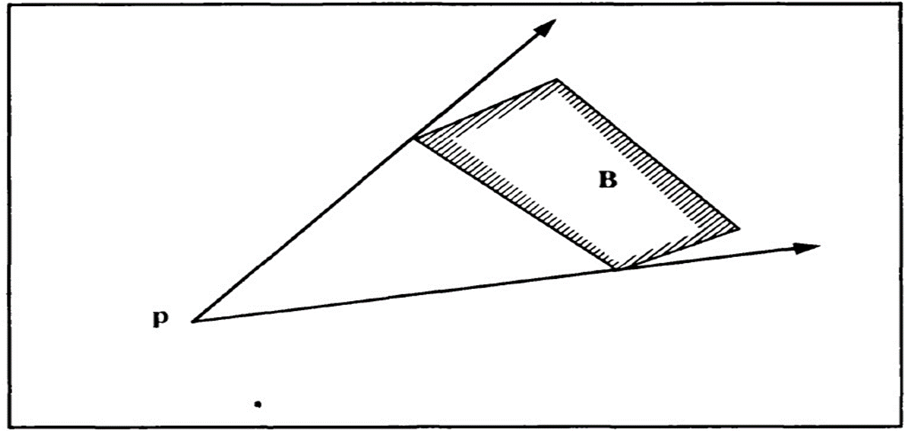
Tangents from Point to Polygon

Slide 15
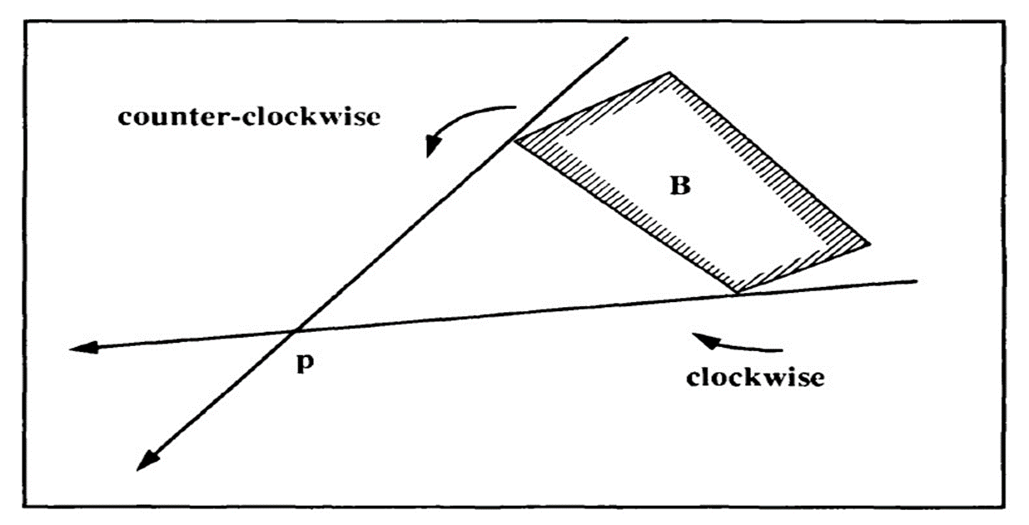
Tangents from Polygon to Point

Slide 16
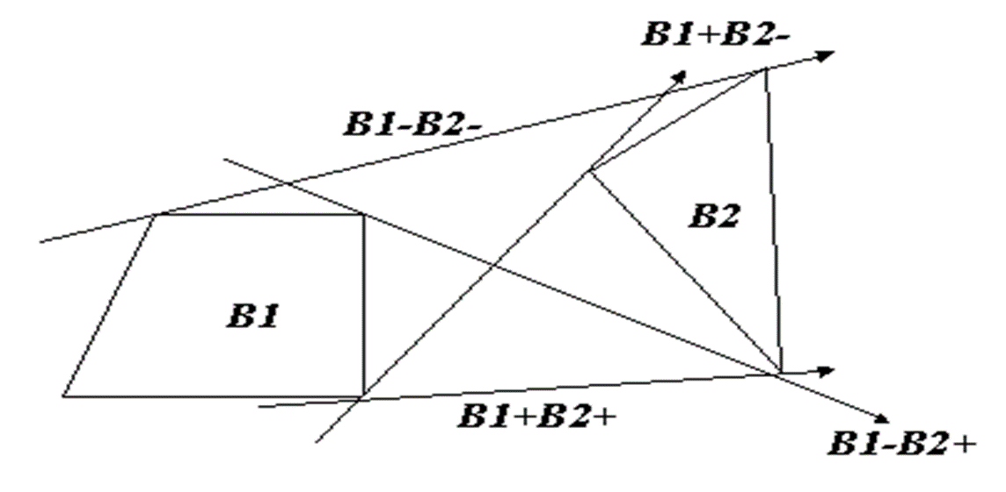
Common Tangents between two Polygons

Slide 17
AGENDA
1. Problem statements
2. Polygonal World and Voronoi diagram
3. Paths Class ( Undirected and Directed )
4. Tangents on Polygons
5. Canonical Paths and Directed v-edges Sequences
6. Connectivity Graph and Sub-Polygons
7. Dijkstra Algorithm
8. Finding the Best Path Class
9. Image of Point on Convex Polygon
10. visibility
11. Project Flow
12 . Demo
13 . Testing

Slide 18
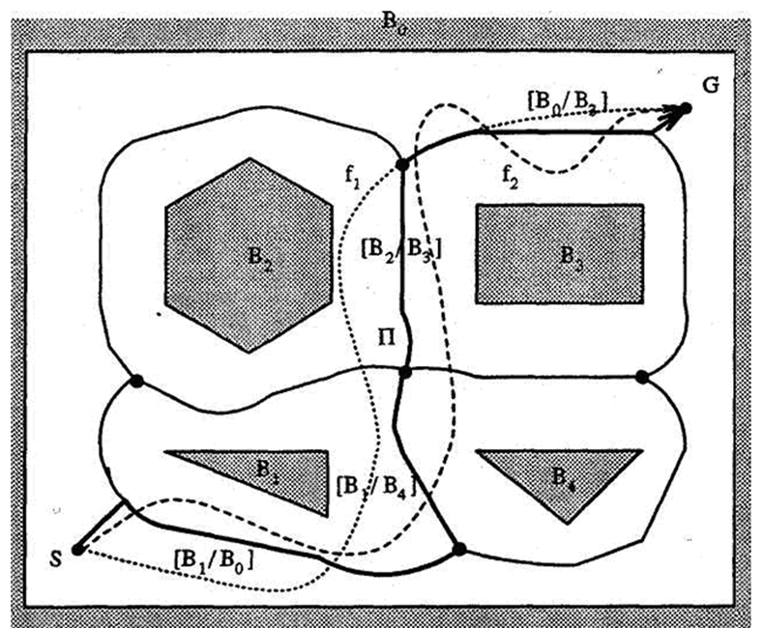
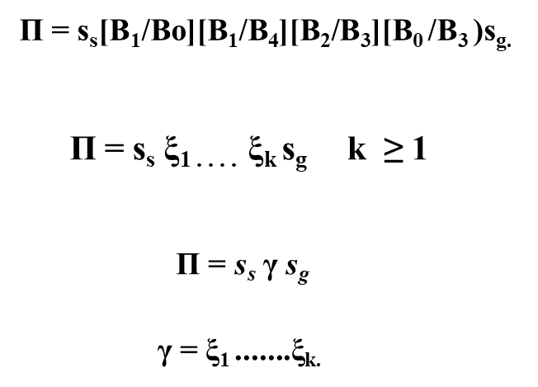
Canonical Paths and Directed v-edges Sequences
Note :-
Π = canonical path
ξ = v-edge
γ = Global path

Slide 19
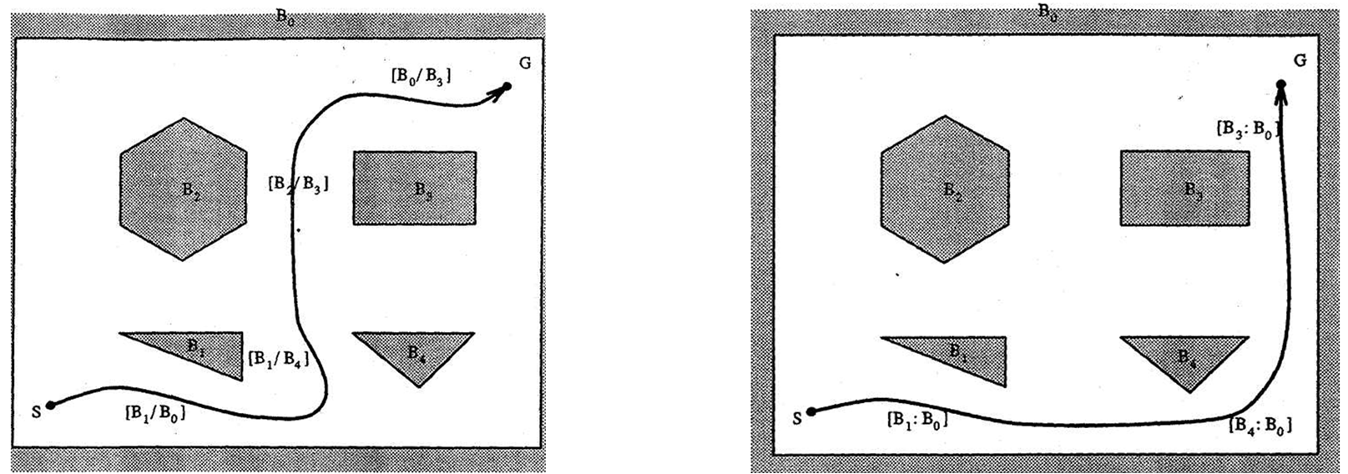
Canonical Paths and Directed v-edges Sequences
γ1 = [B1 /B0][B1 /B4][B2/B3][B0/B3]
γ2 = [B1 /B0][B4 /B0][B3 /B0]

Slide 20
AGENDA
1. Problem statements
2. Polygonal World and Voronoi diagram
3. Paths Class ( Undirected and Directed )
4. Tangents on Polygons
5. Canonical Paths and Directed v-edges Sequences
6. Connectivity Graph and Sub-Polygons
7. Dijkstra Algorithm
8. Finding the Best Path Class
9. Image of Point on Convex Polygon
10. visibility
11. Project Flow
12 . Demo
13 . Testing

Slide 21
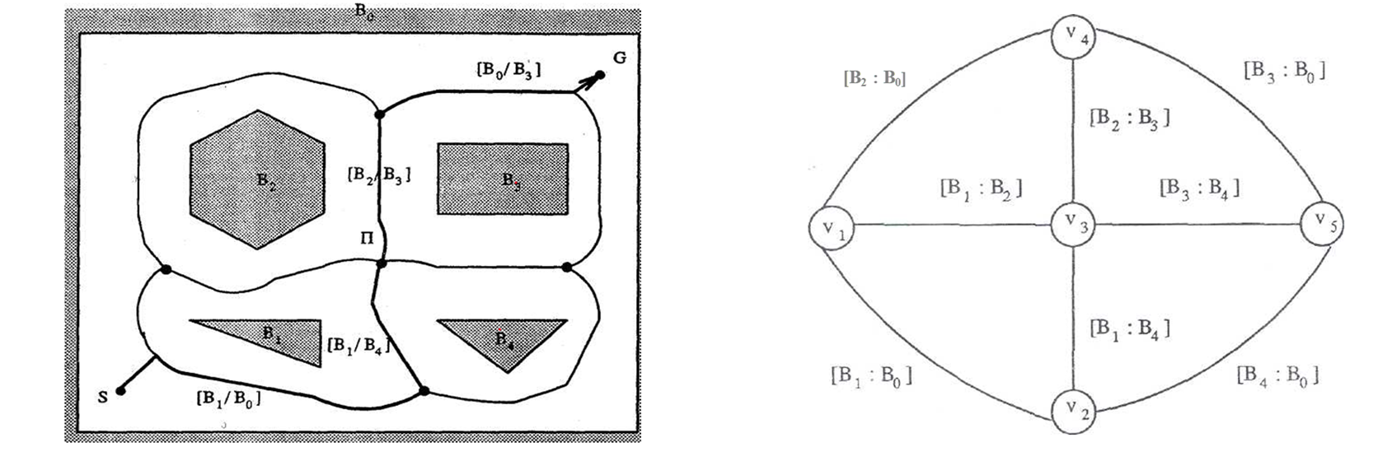
Connectivity Graph

Slide 22
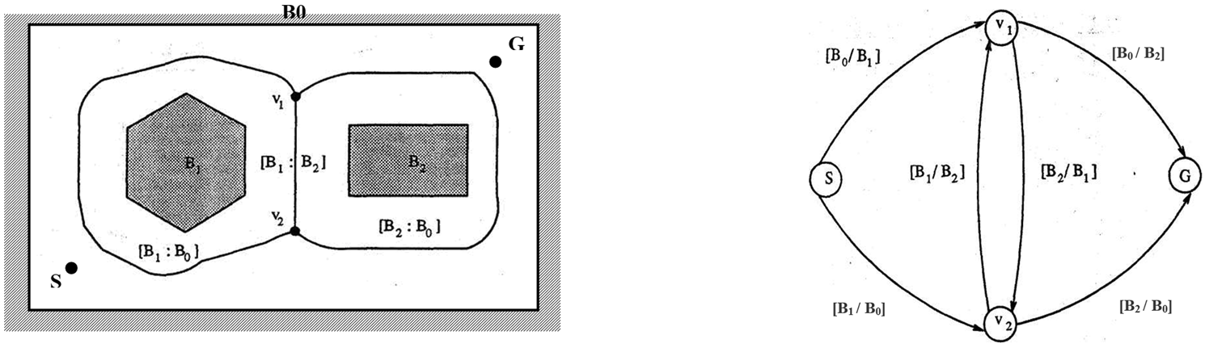
Path Class Representation
π 1 = [B0 / B1] [B0/B2]
π2 =[B0/B1] [B2/B1] [B2/B0]
π3 =[B1/B0] [B1/B2] [B0/B2]
π4 =[B1/B0] [B2/B0]
Note :-
π = Full path

Slide 23
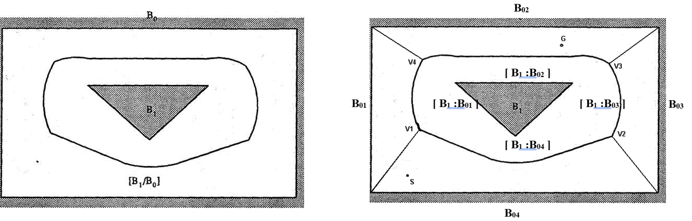
Sub-Polygons

Slide 24
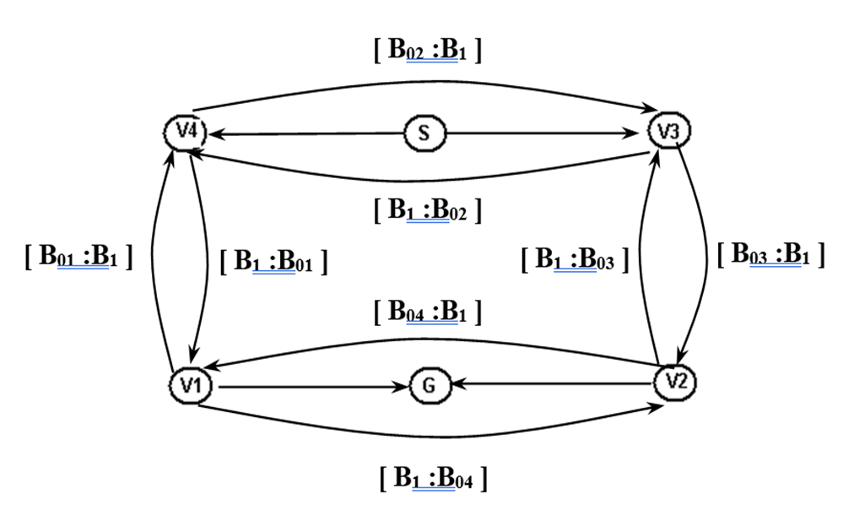
Connectivity Graph

Slide 25
AGENDA
1. Problem statements
2. Polygonal World and Voronoi diagram
3. Paths Class ( Undirected and Directed )
4. Tangents on Polygons
5. Canonical Paths and Directed v-edges Sequences
6. Connectivity Graph and Sub-Polygons
7. Dijkstra Algorithm
8. Finding the Best Path Class
9. Image of Point on Convex Polygon
10. visibility
11. Project Flow
12 . Demo
13 . Testing

Slide 26
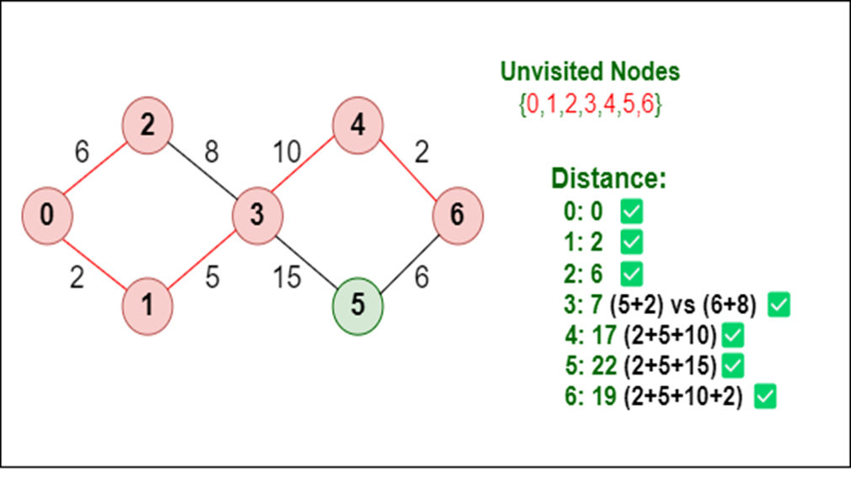
Dijkstra Algorithm
1.Graph Theory
2.Finding Shortest path
3.Algorithms to find optimal path
4.Dijkstra Algorithm
5.Algorithm Complexity

Slide 27
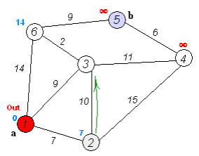
Dijkstra Algorithm
Live Example :

Slide 28
AGENDA
1. Problem statements
2. Polygonal World and Voronoi diagram
3. Paths Class ( Undirected and Directed )
4. Tangents on Polygons
5. Canonical Paths and Directed v-edges Sequences
6. Connectivity Graph and Sub-Polygons
7. Dijkstra Algorithm
8. Finding the Best Path Class
9. Image of Point on Convex Polygon
10. visibility
11. Project Flow
12 . Demo
13 . Testing

Slide 29
Finding the Best Path Class
Proposed approach finds best path class for vehicle.
Proposed approach is efficient, with fast computation time.
O = ((n+m)log n).
Proposed approach is scalable to large and complex environments.
Note :-
O = Big O
n = v-edge
m =v-node

Slide 30
AGENDA
1. Problem statements
2. Polygonal World and Voronoi diagram
3. Paths Class ( Undirected and Directed )
4. Tangents on Polygons
5. Canonical Paths and Directed v-edges Sequences
6. Connectivity Graph and Sub-Polygons
7. Dijkstra Algorithm
8. Finding the Best Path Class
9. Image of Point on Convex Polygon
10. Project Flow
11 . Demo
12 . Testing

Slide 31
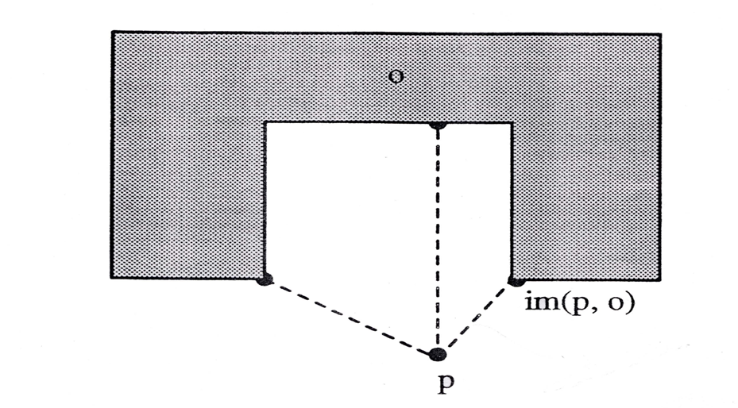
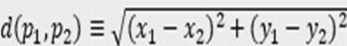
Image of Point on Convex Polygon
Note :-
P = ( x , y )

Slide 32
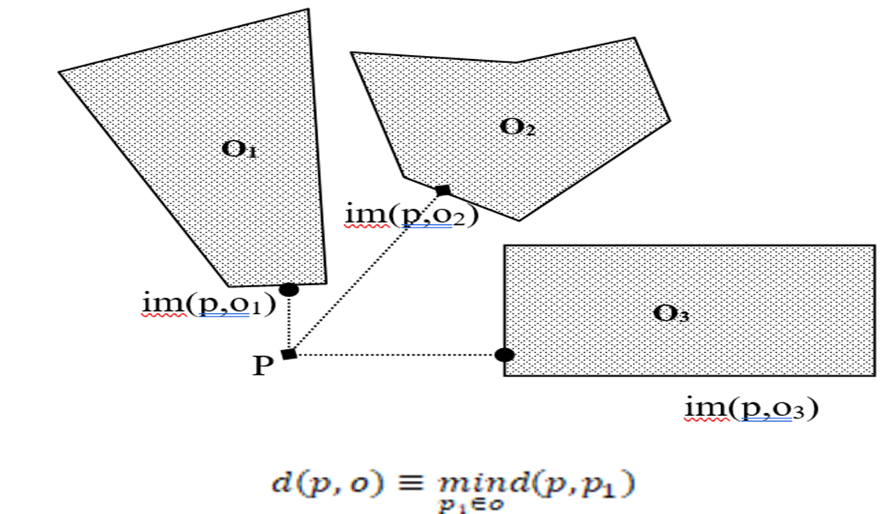
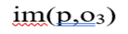

Image of Point on Convex Polygon

Slide 33
AGENDA
1. Problem statements
2. Polygonal World and Voronoi diagram
3. Paths Class ( Undirected and Directed )
4. Tangents on Polygons
5. Canonical Paths and Directed v-edges Sequences
6. Connectivity Graph and Sub-Polygons
7. Dijkstra Algorithm
8. Finding the Best Path Class
9. Image of Point on Convex Polygon
10. visibility
11. Project Flow
12 . Demo
13 . Testing

Slide 34
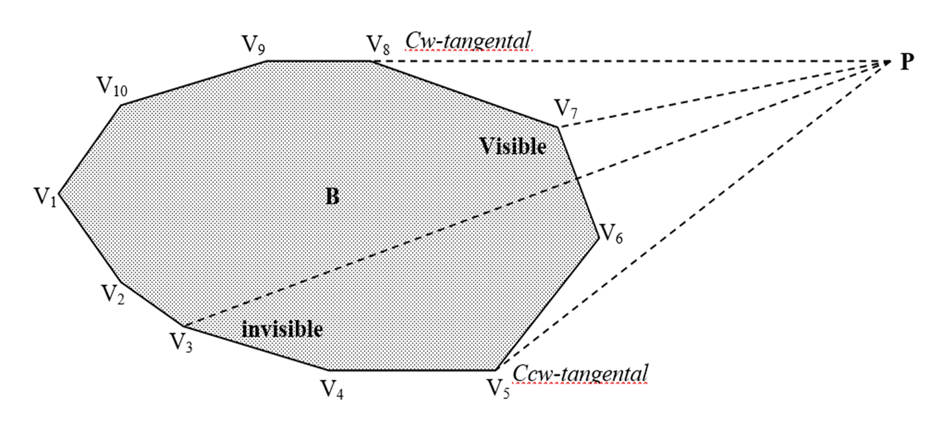
visibility

Slide 35
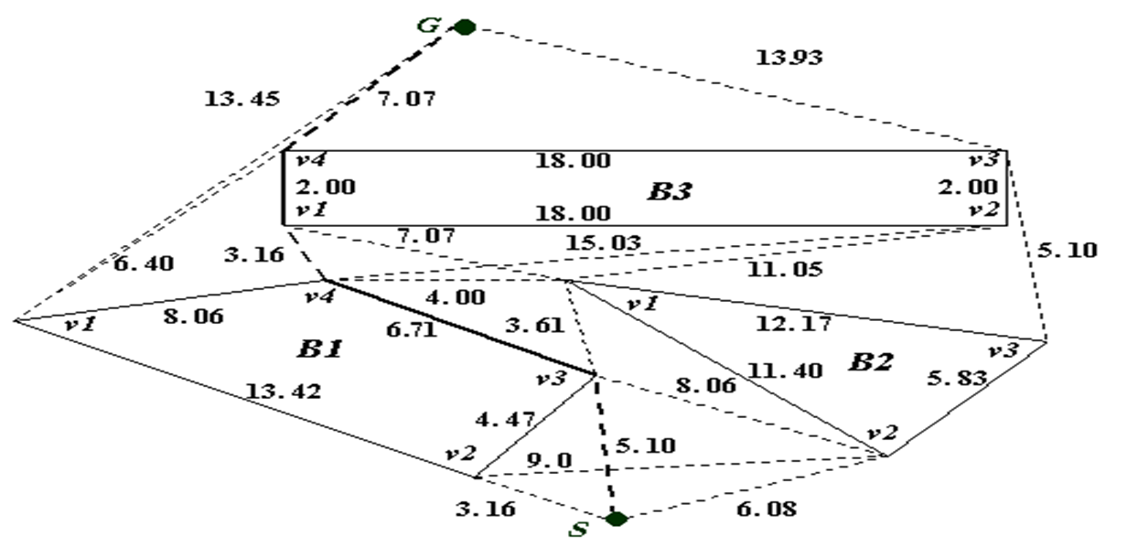
visibility
Shortest Path :
G ←B3- (v4) ←B3- (v1) ←B1+ (v4) ←B1+ (v3) ← S

Slide 36
AGENDA
1. Problem statements
2. Polygonal World and Voronoi diagram
3. Paths Class ( Undirected and Directed )
4. Tangents on Polygons
5. Canonical Paths and Directed v-edges Sequences
6. Connectivity Graph and Sub-Polygons
7. Dijkstra Algorithm
8. Finding the Best Path Class
9. Image of Point on Convex Polygon
10. visibility
11. Project Flow
12 . Demo
13 . Testing

Slide 37
Project Flow
01
02
03
Create world
Add polygons to world
Get all path classes
04
05
06
Apply visibility to get only visible tangent sequences
Get shortest path in each path class (Canonical path)
Get the shortest path through Dijkstra Algorithm

Slide 38
AGENDA
1. Problem statements
2. Polygonal World and Voronoi diagram
3. Paths Class ( Undirected and Directed )
4. Tangents on Polygons
5. Canonical Paths and Directed v-edges Sequences
6. Connectivity Graph and Sub-Polygons
7. Dijkstra Algorithm
8. Finding the Best Path Class
9. Image of Point on Convex Polygon
10. visibility
11. Project Flow
12 . Demo
13 . Testing

Slide 39
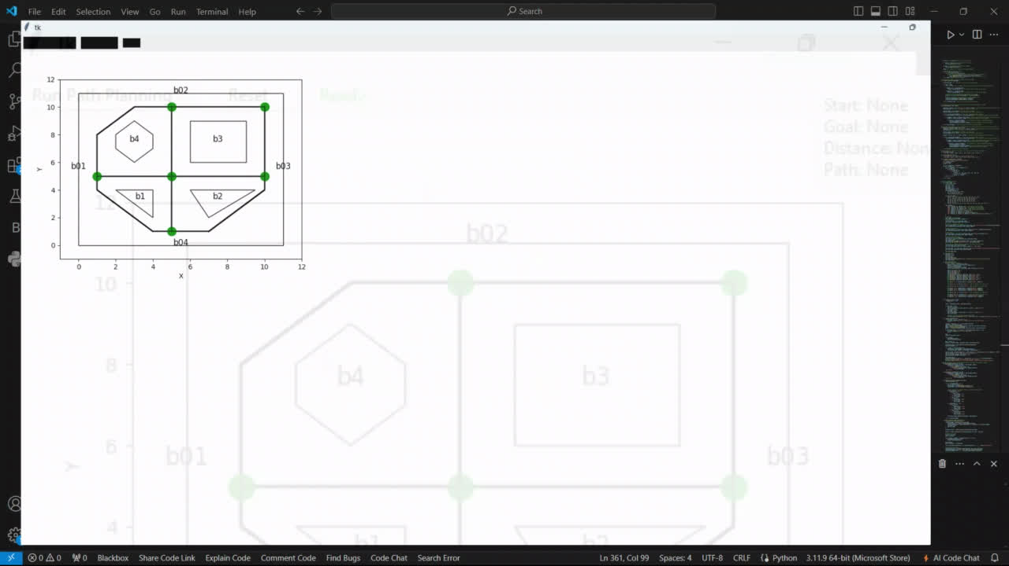
Demo

Slide 40
AGENDA
1. Problem statements
2. Polygonal World and Voronoi diagram
3. Paths Class ( Undirected and Directed )
4. Tangents on Polygons
5. Canonical Paths and Directed v-edges Sequences
6. Connectivity Graph and Sub-Polygons
7. Dijkstra Algorithm
8. Finding the Best Path Class
9. Image of Point on Convex Polygon
10. visibility
11. Project Flow
12 . Demo
13 . Testing

Slide 41
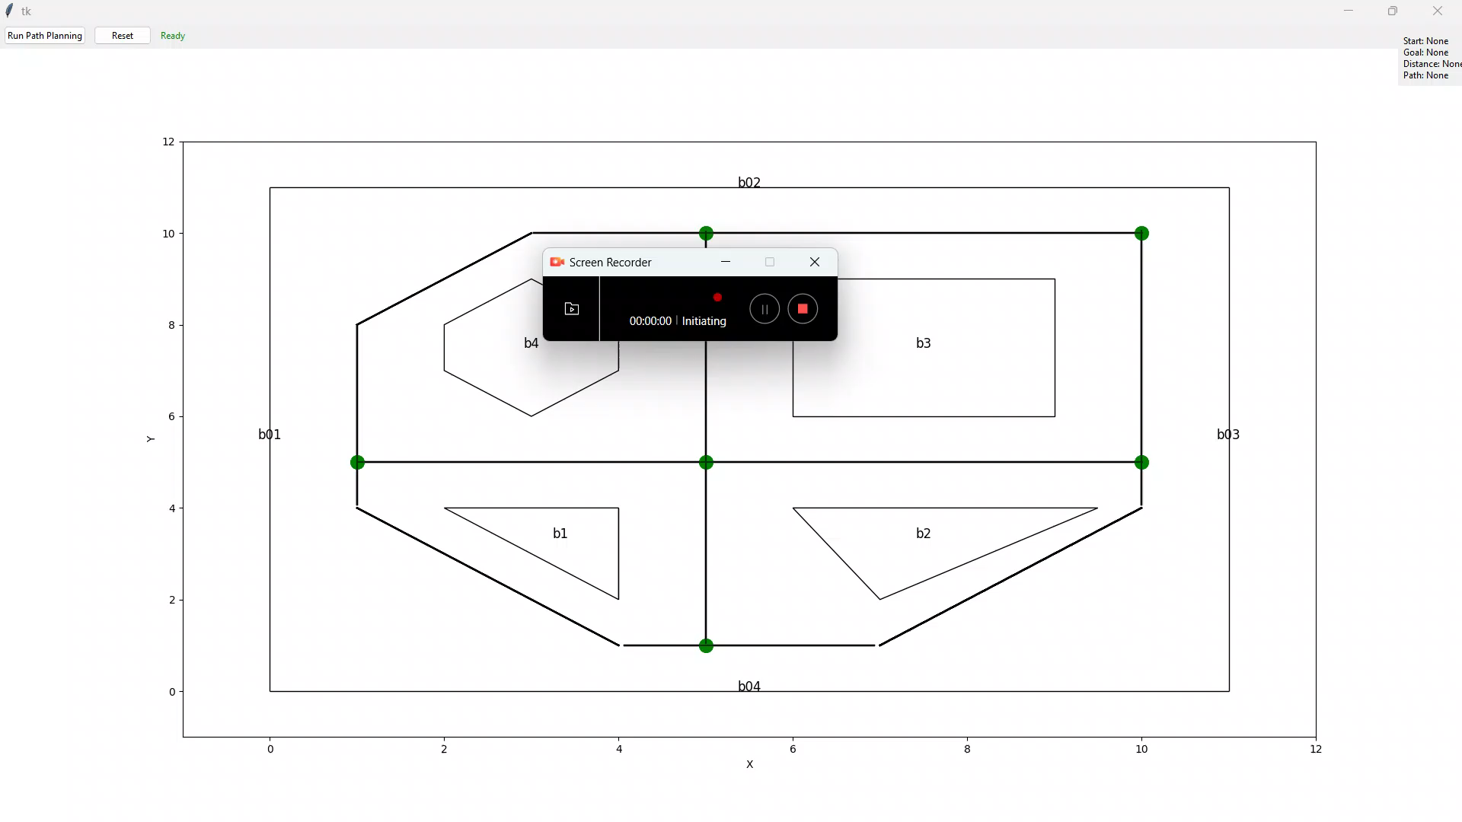
Testing

Slide 42
Thank
You

